Slide 1
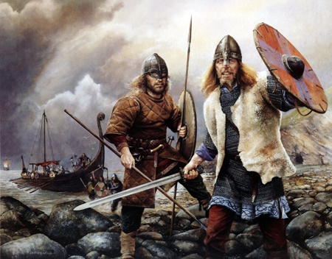
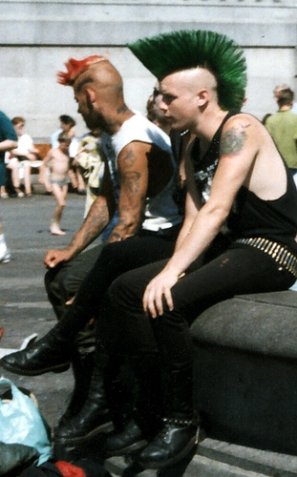
FROM OLD BARBARIANS…
… TO NEW BARBARIANS
A SHORT HISTORY OF THE ENGLISH LANGUAGE

Slide 2
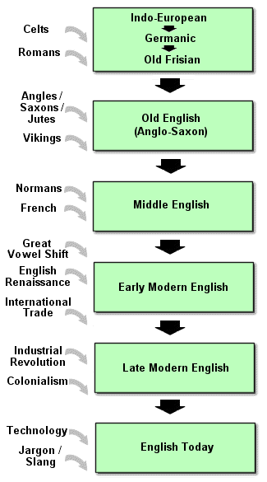
SUMMARY

Slide 3
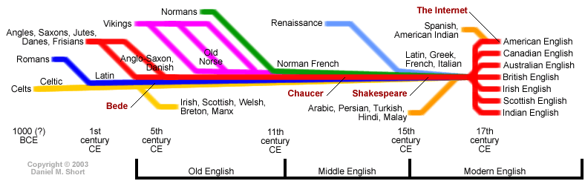
TIMELINE

Slide 4
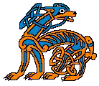
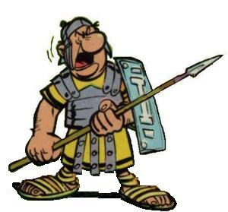
BEFORE ENGLISH
200 B.C. THE FIRST INHABITANTS OF THE BRITISH ISLES SPOKE CELTIC.
THERE ARE CELTIC PLACE NAMES IN BRITAIN: AVON = RIVER, DOVER = WATER
55 A.D. THE ROMANS SPOKE LATIN IN BRITAIN, BUT THE BRITISH DID NOT.
PLACE NAMES: Winchester, Lancaster, Manchester (from “castra” = camp)

Slide 5
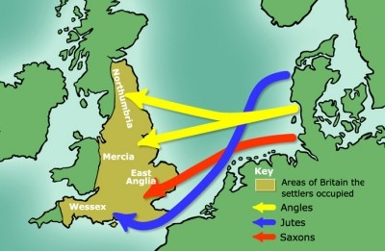
OLD ENGLISH (500 – 1100)

Slide 6
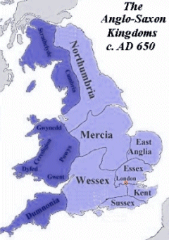
Germanic invaders – the ANGLES, the SAXONS and the JUTES occupied Britain and pushed the Celts to the borders. They called their language “Englisc”.
The basic words of English are of Anglo Saxon origin.
Ex: father, man, child, you, drive, work, pig, this, dog, wife, daughter, house, people, family, water, time, fish, look, night, day, sun, what, some

Slide 7
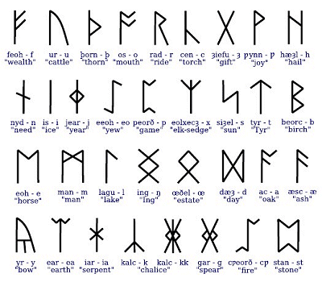
The Celts and the early Anglo-Saxons used an alphabet of RUNES, originally developed for scratching onto wood or stone.

Slide 8
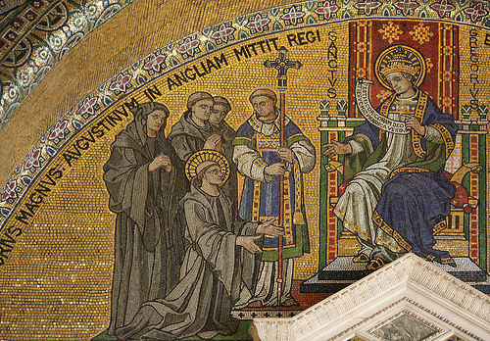
THE CHRISTIAN MISSIONARIES
St. Augustine and other Christian missionaries converted the British to Christianity. They brought the Bible and other books.
ex: fork, school, spider, tower, rose, lily, cross, paradise, paper, angel.

Slide 9

PADRE NOSTRO
Fæder ure þu þe eart on heofonum; Si þin nama gehalgod to becume þin rice gewurþe ðin willa on eorðan swa swa on heofonum. urne gedæghwamlican hlaf syle us todæg and forgyf us ure gyltas swa swa we forgyfað urum gyltendum and ne gelæd þu us on costnunge ac alys us of yfele soþlice | Father our thou that art in heavens be thy name hallowed come thy kingdom be-done thy will on earth as in heavens our daily bread give us today and forgive us our sins as we forgive those-who-have-sinned-against-us and not lead thou us into temptation but deliver us from evil. truly

Slide 10
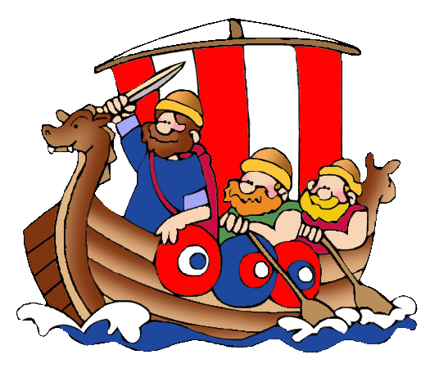
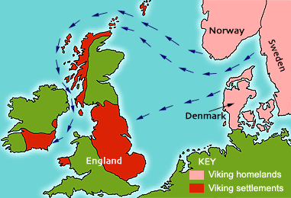
THE VIKINGS
Vikings from Scandinavia invaded Britain in 800 A.D.. More than 900 words of English are of Scandinavian origin
Ex: get, want, leg, skirt, sky, skin, die.

Slide 11
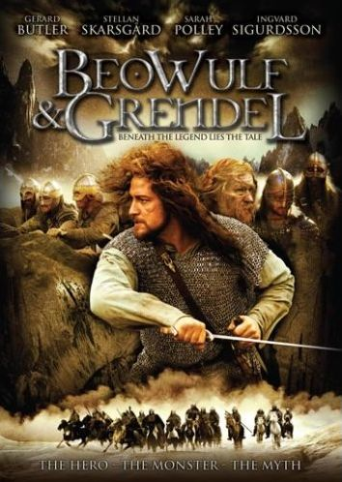
BEOWULF
Beowulf is the most important literary work in Old English.
This epic poem describes the hero Beowulf marching with his fourteen warriors and arriving at Heorot.
The king of Heorot is terrified by a monster called Grendel. Beowulf kills Grendel and his monster-mother. After that he returns to his country and becomes the king there and rules his kingdom for fifty years.
He dies of the wounds he got once during the combat fought with a dragon.

Slide 12
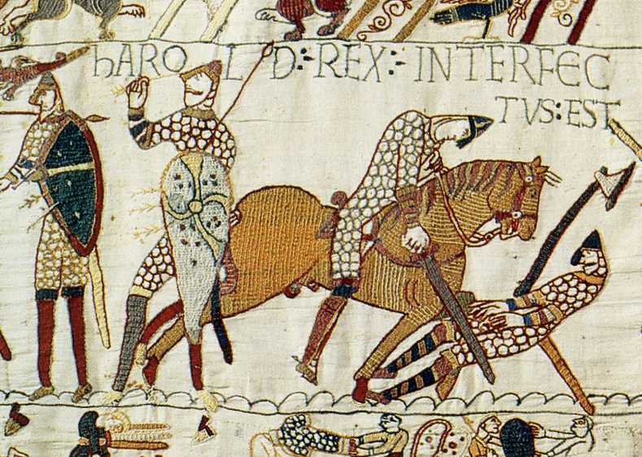
MIDDLE ENGLISH (1100-1500)
1066 A.D. : William the Conqueror with the Normans from Northern France invaded Britain. They spoke a French dialect that became “Anglo-Norman”. They ruled Britain for over 300 years. Common people continued to speak English and the official documents were written in Latin. This mixture of Old English and Anglo-Norman that is usually referred to as Middle English.

Slide 13
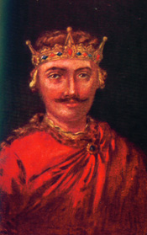
The words related to humble activities were in Anglo Saxon:
Baker, miller, shomaker, shhep, cow, pig….
While the French was used to talk about more important or sophisticated things: painter, merchant, beef, bacon, castle, prince, judge, court, battle, soldier, peace, money, beauty, jewel, biscuit, mirror, poet, chapter, literature, uncle, parents, park, nation.
Sometimes they combined to form a new word: gentle-man
William the Conqueror

Slide 14

During these centuries in which English as a language had no official status and no regulation, English had become the third language in its own country. It was largely a spoken rather than written language, there were many dialects and people couldn’t understand each other. But English became much easier.
The universities of Oxford and Cambridge were founded in 1167 and 1209 .

Slide 15
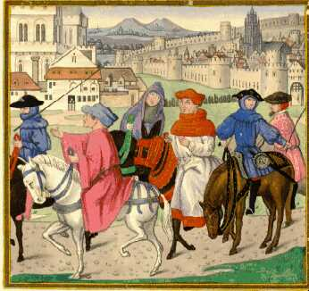
GEOFFREY CHAUCER
“THE CANTERBURY TALES” (1380)
It is the story of a group of pilgrims going to the shrine of Sir Thomas Beckett in Canterbury. Everyone has to tell a story.
It is considered the first work of English literature. Chaucer introduced 2000 new words like ignorant, difficult, examination, finally, scissors, theatre, village.

Slide 16
Canterbury Tales: prologue
Here bygynneth the Book
of the tales of Caunterbury
1: Whan that aprill with his shoures soote
2: The droghte of march hath perced to the roote,
3: And bathed every veyne in swich licour
4: Of which vertu engendred is the flour;
5: Whan zephirus eek with his sweete breeth
6: Inspired hath in every holt and heeth
7: Tendre croppes, and the yonge sonne
8: Hath in the ram his halve cours yronne,
9: And smale foweles maken melodye,
10: That slepen al the nyght with open ye
11: (so priketh hem nature in hir corages);
12: Thanne longen folk to goon on pilgrimages

Slide 17
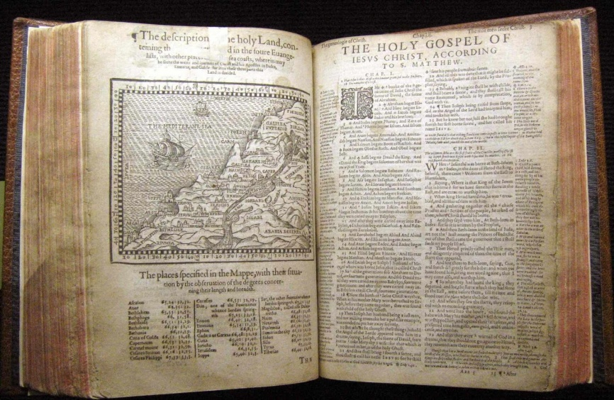
MODERN ENGLISH (early) 1500-1800
In 1476 William Caxton introduced the printing press in Britain. This was an incredibly important event because it helped to unify the various dialects and spellings of the words in the Country.
In these centuries the first Bible in English was printed and the first English dictionary was published.

Slide 18
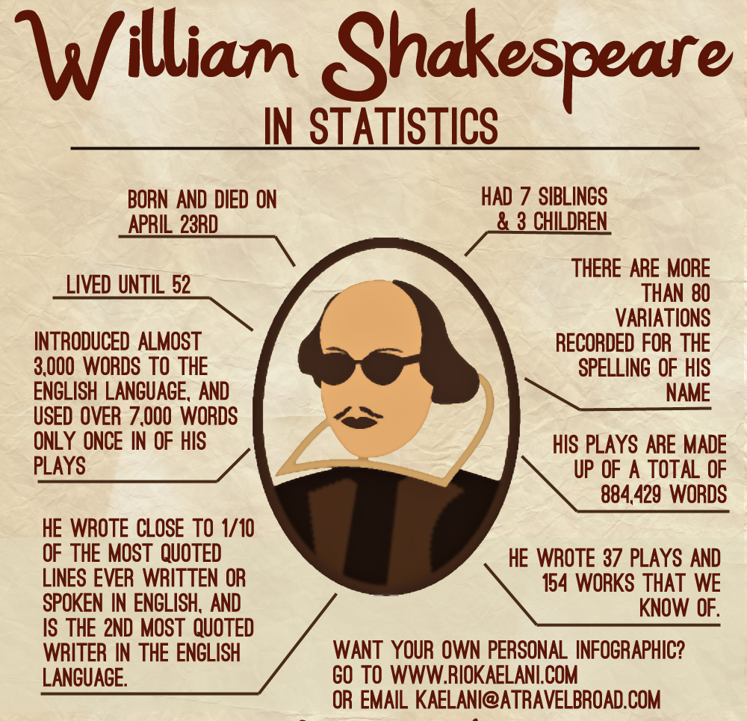
William Shakespeare
Whatever the merits of the other contributions to this golden age, though, it is clear that one man, William Shakespeare, changed the English language in the late 16th and early 17th Century.

Slide 19
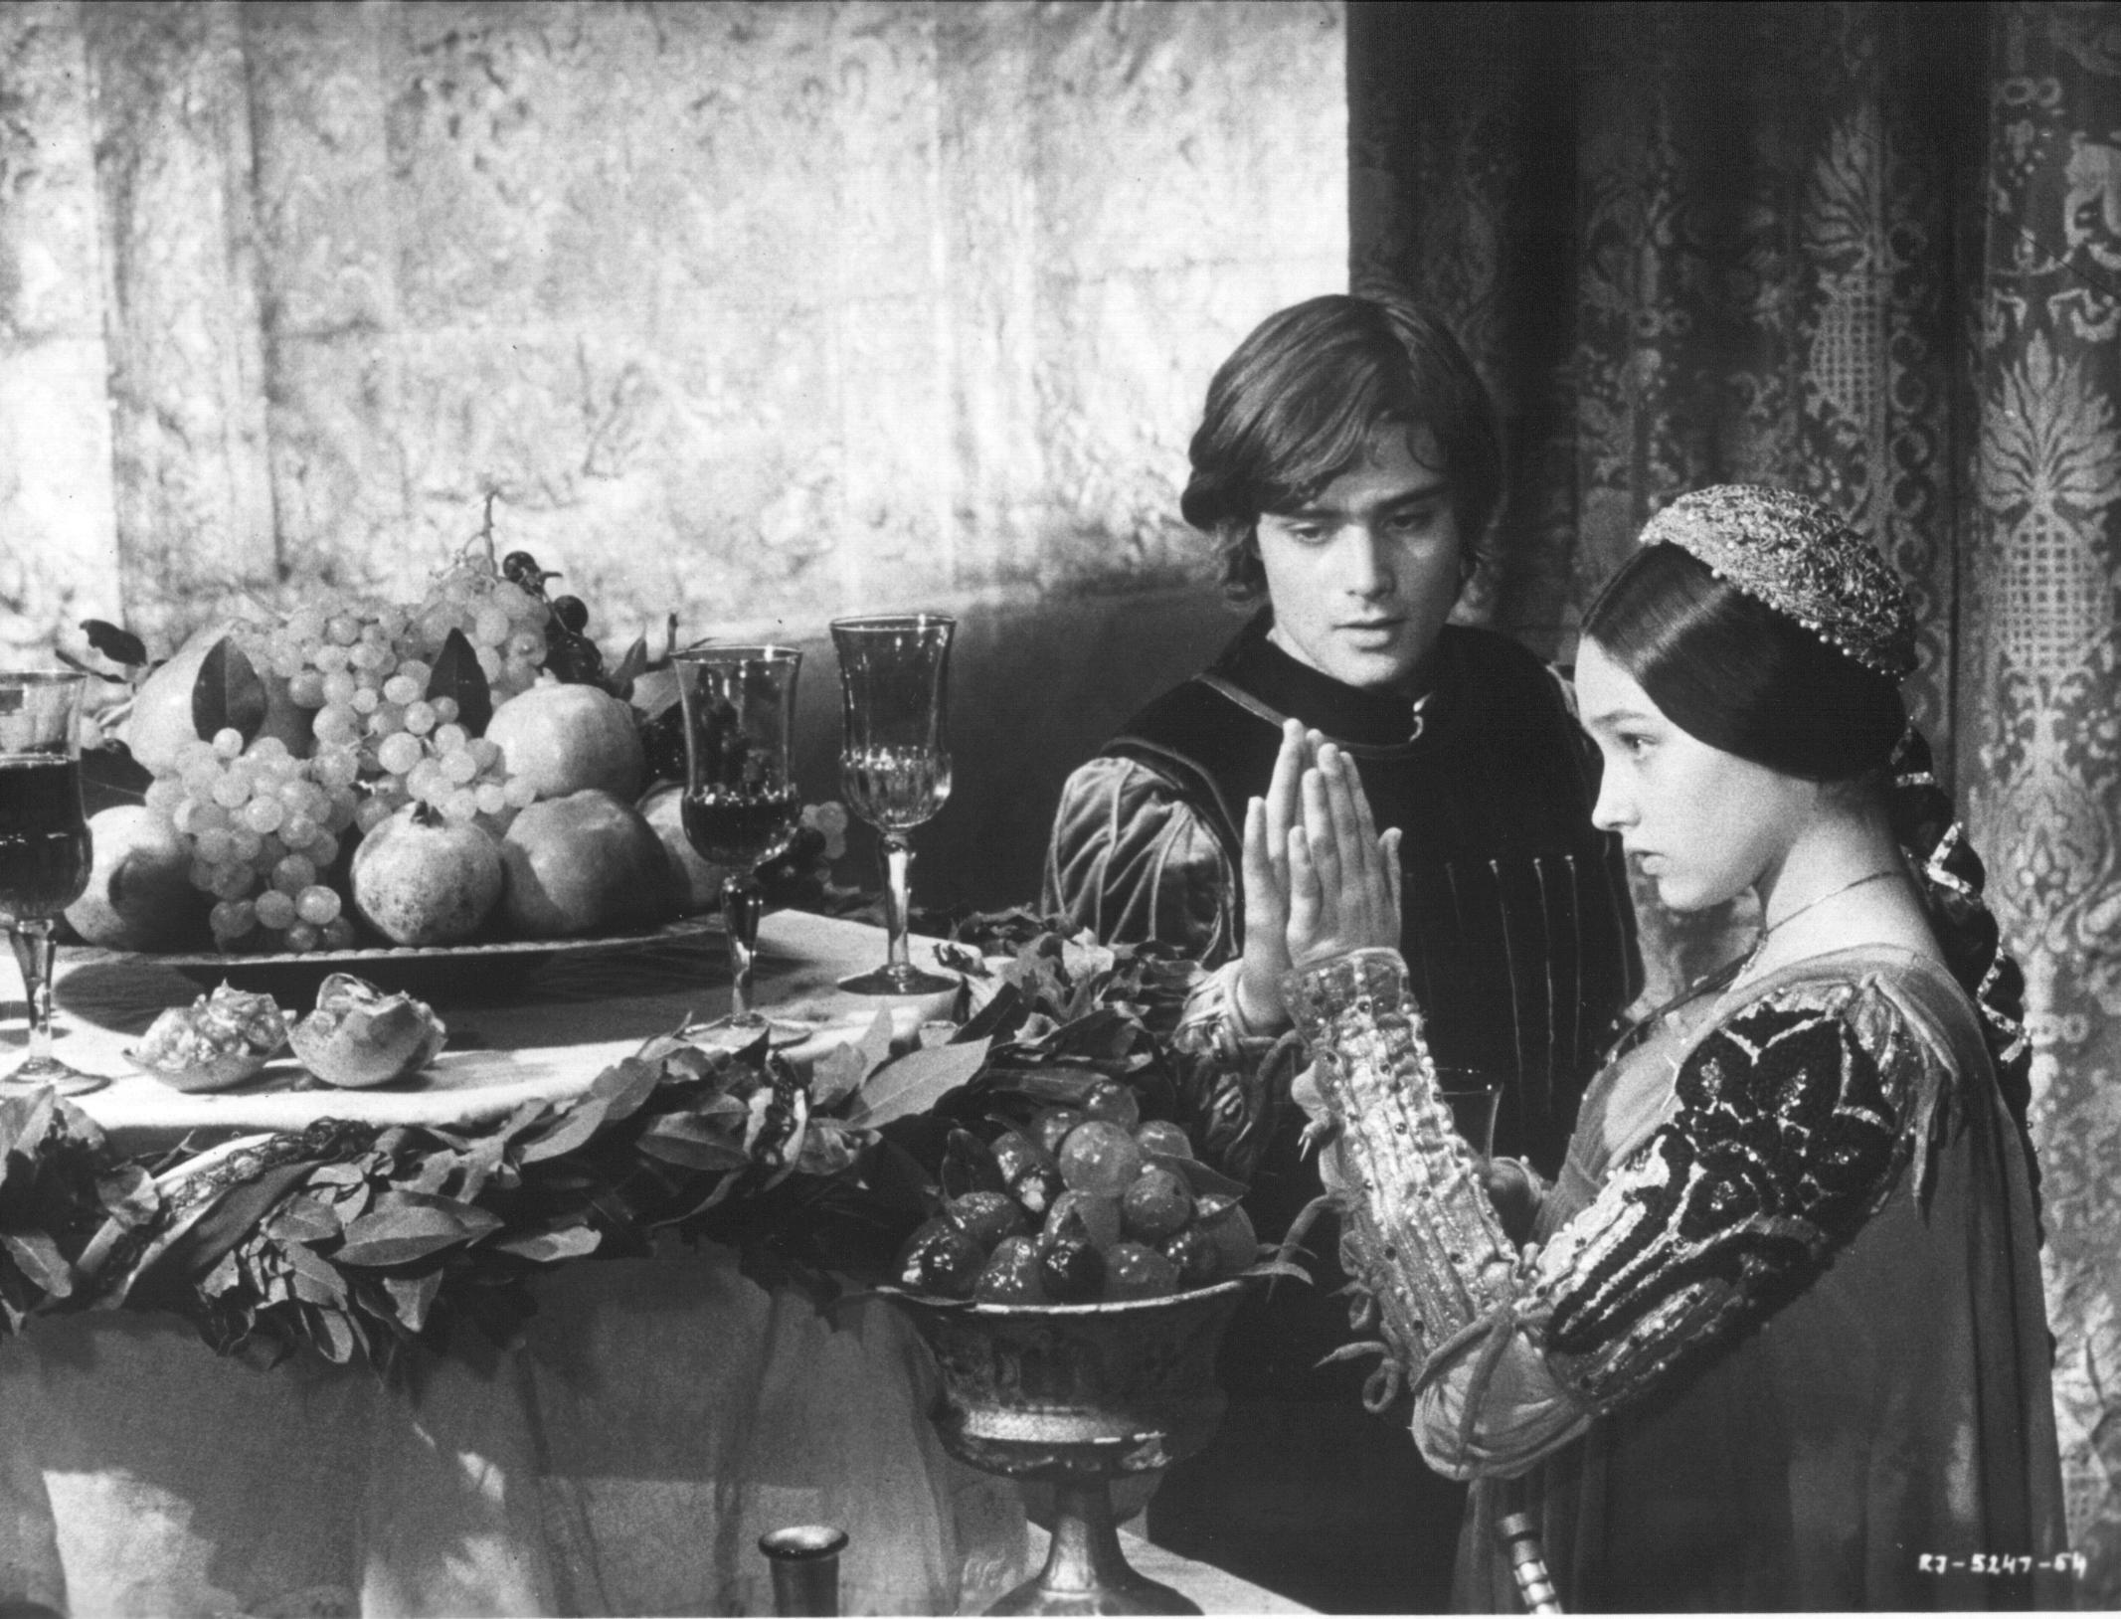
He personally coined about 2,000 neologisms or new words in his many works, including, monumental, majestic,obscene, homicide, assassination, courtship, eyeballs, accommodation, excellent, hurry, lonely, and hundreds of other terms still commonly used today. Almost one in ten of the words used by Shakespeare were his own invention!
Thee, thou and thy (signifying familiarity or social inferiority), were still present.Thee and thou disappeared almost completely by the middle of the 17th Century.

Slide 20
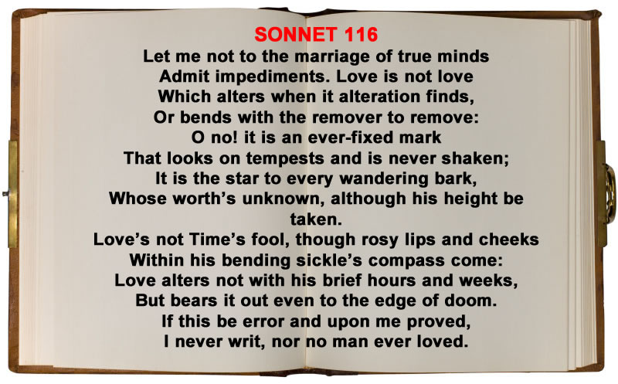
Early Modern English had a different pronunciation from today’s English.
So sometimes we cannot appreciate completely his works..

